Slide 1
DESIGN AND ANALYSIS OF ALGORITHM
ASSIGNMENT_6
RAUNAK RATHORE IIT2019222
PRINCE KUMAR GUPTA IIT2019223
SHIVANGI VERMA IIT2019224

Slide 2
PROBLEM :
8 PUZZLE PROBLEM

Slide 3
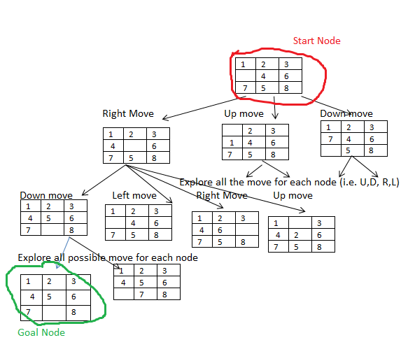
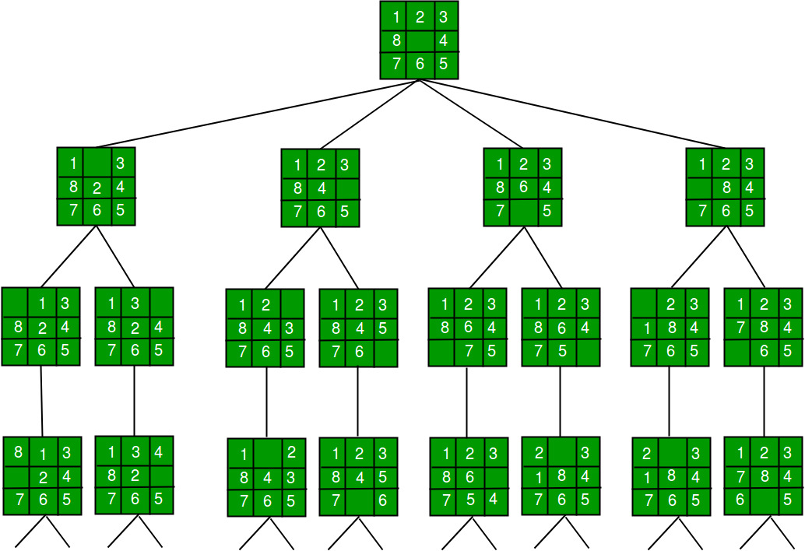
You can enter
Notes:
Raunak

Slide 4
PSUEDO CODE:
16: x− >parent = E; // Pointer for path to root
17: end for
18:
19: if there are no more live nodes then
20: print(”No answer node”)
21: return
22: end if
23:
24: // Find a live node with least estimated cost
25: E = Least();
26: // The found node is deleted from the list of
27: // live nodes
28: end while
29: end function
1: function LCSEARCH(listnode ∗ t)
2: if t is an answer node then
3: print(t)
4: return
5: end if
6: E = t; // E-node
7: Initialize the list of live nodes to be empty;
8:
9: while (true)
10: for each child x of E
11: if x is an answer node then
12: print(path from x to t)
13: return
14: end if
15: Add (x); // Add x to list of live nodes;
Notes:
Tez

Slide 5
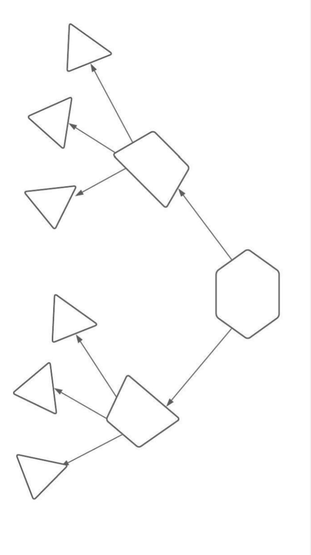
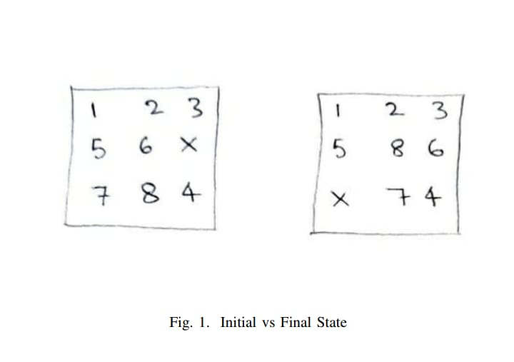
INITIAL & FINAL STATES
Notes:
divyansh

Slide 6
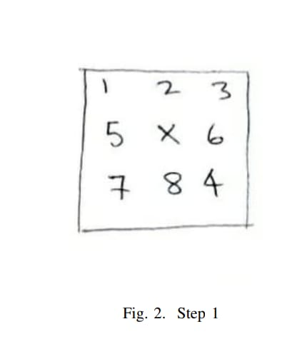
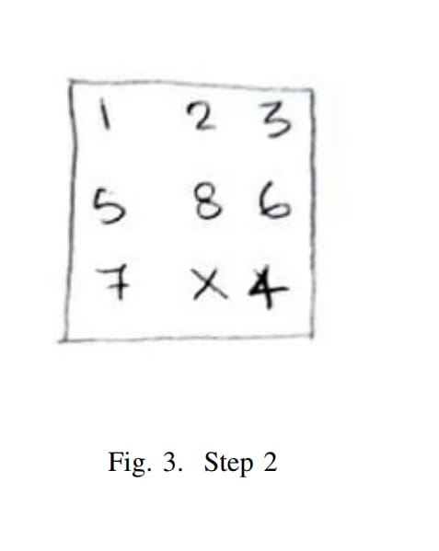
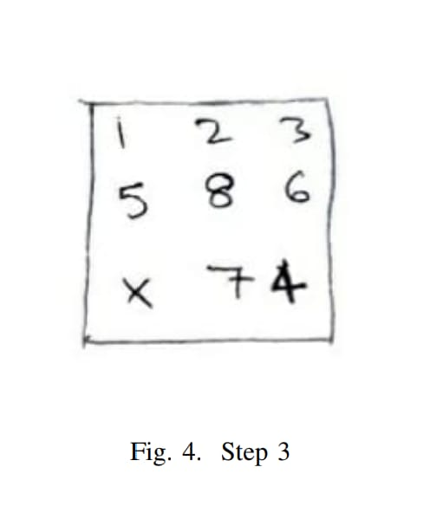
STEPS FOR DESTINATION STATE

Slide 7
TIME COMPLEXITY ANALYSIS :
We keep running the BFS-like search until the destination state is not reached. For each state we generate an average of three new children and if the final state is found at a depth of D then the number of nodes generated will be (avg-number-of-children)D.
Avg no of children = (corner-points*2 + middle-point*4 + edge-middle-point*3)/9 = (4*2+1*4+4*3)/9 = 2.66 Since the weightage of the middle point will be more, we can approximate it to 3. So, the worst time complexity will be O(3D) where D is the depth of the final state from initial state. The best case time complexity will be O(1) when either the solution is not possible or the initial state is equal to the final state

Slide 8
SPACE COMPLEXITY
Space complexity will be equal to the number of nodes traversed*size-of-one-state.
So,
Worst case space complexity = O(9!*size-of-one-state).
Best case space complexity will be O(1) when either the initial state and final states are the same or the solution is not feasible.

Slide 9
THANKS

